Slide 1
Chapter 6

Slide 2
Objectives

Slide 3
Objectives (cont.)

Slide 4
The Future Value application with a logic error

Slide 5
The goal of testing

Slide 6
Three test phases

Slide 7
The three types of errors that can occur

Slide 8
Code that contains syntax errors

Slide 9
Common syntax errors

Slide 10
Problems with identifiers

Slide 11
Problems with values

Slide 12
A problem with floating-point numbers

Slide 13
Code that uses println() to trace execution

Slide 14
The data that’s printed to the console

Slide 15
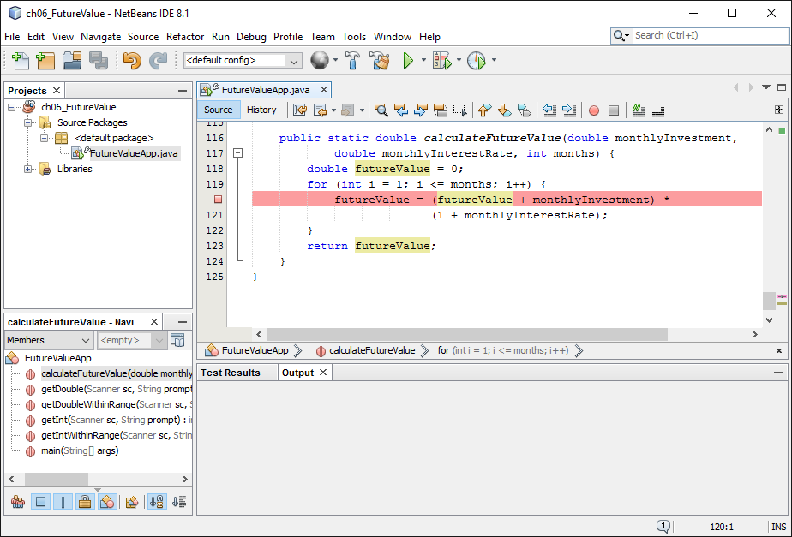
A code editor window with a breakpoint

Slide 16
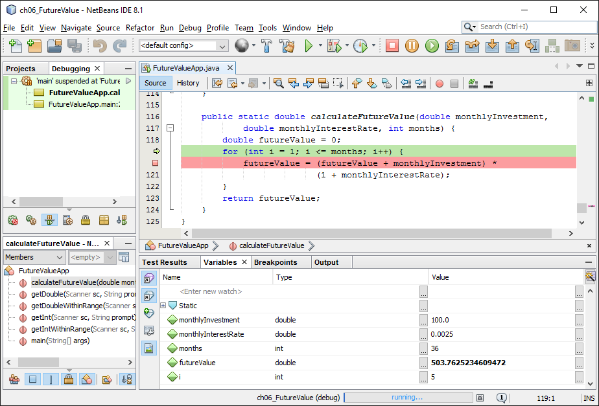
A debugging session

Slide 17
Some of the buttons on the Debug toolbar

Slide 18
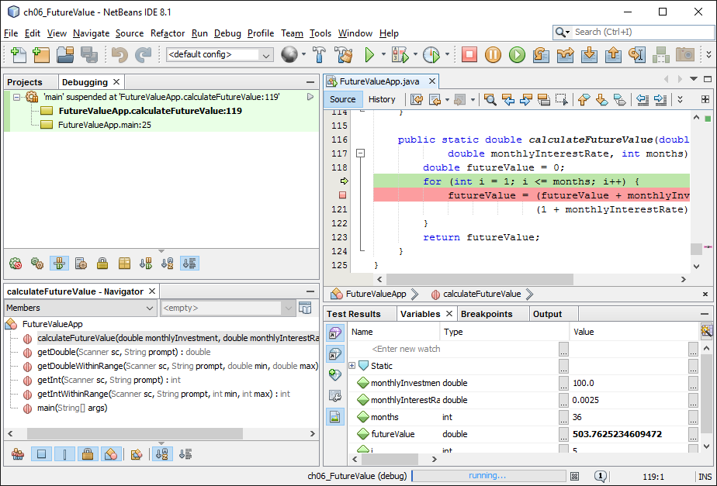
The Call Stack window during debugging

Slide 19
Executable JAR file

Slide 20
Web Start

Slide 21
Installer program

Slide 22
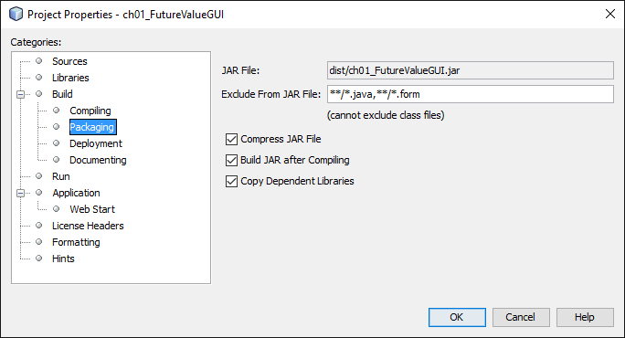
The properties for building a project

Slide 23
How to deploy the files for an application

Slide 24
A GUI application running outside of an IDE

Slide 25
A console application running in the Windows command prompt

Slide 26
A batch (.bat) file that runs a console application on Windows

